Slide 1
Feasibility Studies
Basic Introduction

Slide 2
The Feasibility Study- Overview
Definition
  A document written to show the practicality of a proposed policy, product, service, or other change within an organization
  Examines details such as costs, alternatives, and likely effects
  Reflects the objectivity of a report
  End result is to convince readers:
    To adopt or reject the one idea discussed
    To adopt one of several alternatives presented in the study

Slide 3
The Feasibility Study- Parts
General Report Contents
  Cover Page
  Memo
  Table of Contents
  Executive Summary
  Report

Slide 4
Cover Page
Attractive and Informative
Reader’s First Impression
Genre Differences

Slide 5

Cover Page
May include some or all of the following:
  Project Title
    Be Consistent
  Client’s or Recipient’s Name
    “Prepared for X”
  Your Name and/or Organization Name
    “Prepared by X”
  Date of Submission

Slide 6
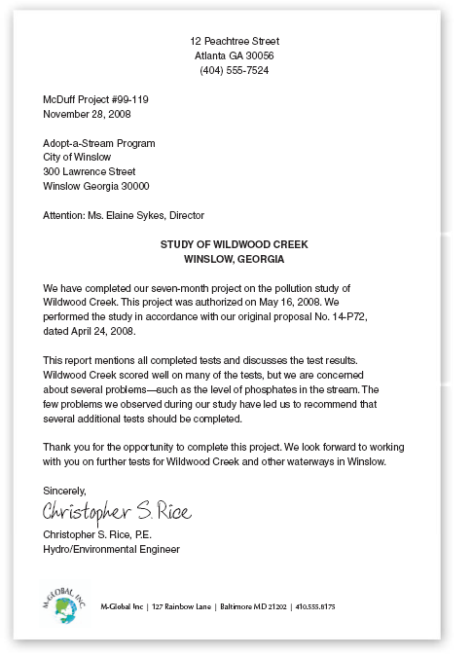
Memo
Quick Report Introduction
Explains Context
Introduces Major Report Point
  May include background information
Follow-Up Contact

Slide 7
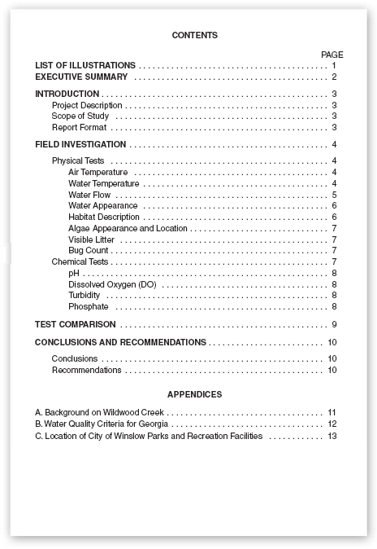
Table of Contents
Important for Longer Reports
Organized and Appealing
Divided by Categories and Subcategories

Slide 8
Executive Summary
Brief statement about who has authorized the study and for what purpose
Brief mention of the criteria used during the evaluation
Brief reference to your recommendation

Slide 9
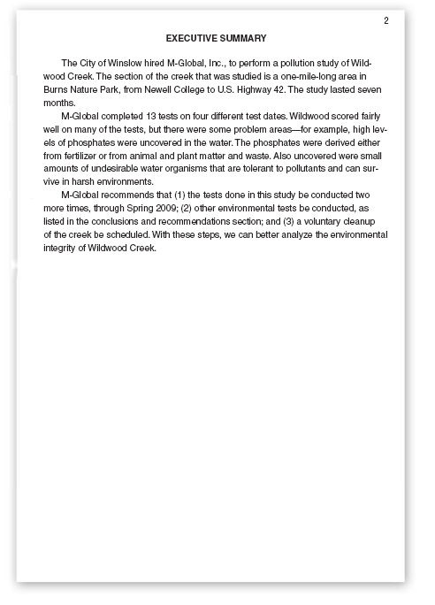
Executive Summary
  One Page
  Avoid Technical Jargon
  Important Conclusions and Recommendations
  Avoid Report Body References
  Paragraph Format
  Written Last

Slide 10
Report
Choose Format Carefully
Use the ABC Structure
  Abstract
    Introduction
  Body
    Details that support conclusions and recommendations
  Conclusion
    Wrap-up of conclusions and recommendations

Slide 11
Report Introduction
Organization
  State your purpose and lead-in to subsections
  Include a project description
  Include scope information
  Consider including information on report format

Slide 12
Report Body
Organization
  Describe evaluation criteria
  Describe exactly what was evaluated and how
  Choose criteria that are most meaningful to readers
  Discuss both advantages and disadvantages
  Follow organization guidelines for comparisons

Slide 13
Report Body
Format
  Use frequent headings and subheadings
  Use listings to break up long paragraphs
  Use illustrations for clarification and persuasion

Slide 14
Report Conclusion
Organization
  Detailed Conclusions and Recommendations
    Convictions or beliefs based on the findings in your study
    Actions you are suggesting based on your conclusions
  Use Graphics for Comparisons
  Offer to Meet with the Readers

Slide 15
Feasibility Studies
Basic Introduction

